Slide 1

DIGITAL SCAM
ONLINE SHOPING SCAM WEBSITE

Slide 2
ONLINE SHOPINP WEBSITE
ONLINE SHOPING WEBSITE :- A website which use for buying clothes by online shoping website
Design Language’s :- HTML, CSS, JAVASCRIPT

Slide 3
TABLE OF CONTENTS
01
02
03
04
WEBSITE DASHBROAD
SELECT AND ADD TO CART
IT’S A WEBSITE MAIN FRONT WHICH IS REPRESENT SELLING PRODUCT
SELECT THE PRODUCT AND CLICK ON ADD TO CART BUTTON
BUY AND ADDRESS
PAYMENT SYSTEM
BUY THE PRODUCT AND FILL THE ADDRESS
TO PAY YOUR BILL

Slide 4

01
WEBSITE DASHBROAD
IT’S A WEBSITE MAIN FRONT WHICH IS REPRESENT SELLING PRODUCT

Slide 5
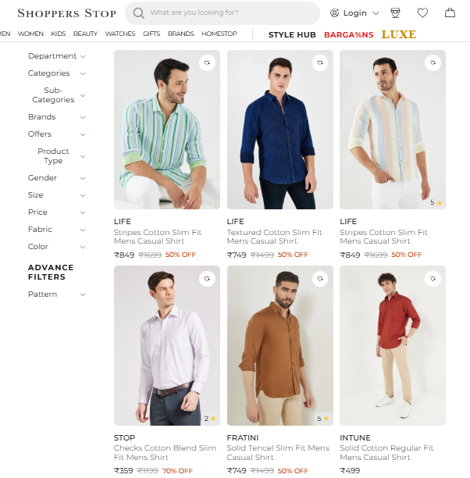
WEBSITE DASHBROAD
SHOPPERS SHOP is a website which sell his own product

Slide 6

02
SELECT AND ADD TO CART
SELECT THE PRODUCT AND CLICK ON ADD TO CART BUTTON

Slide 7
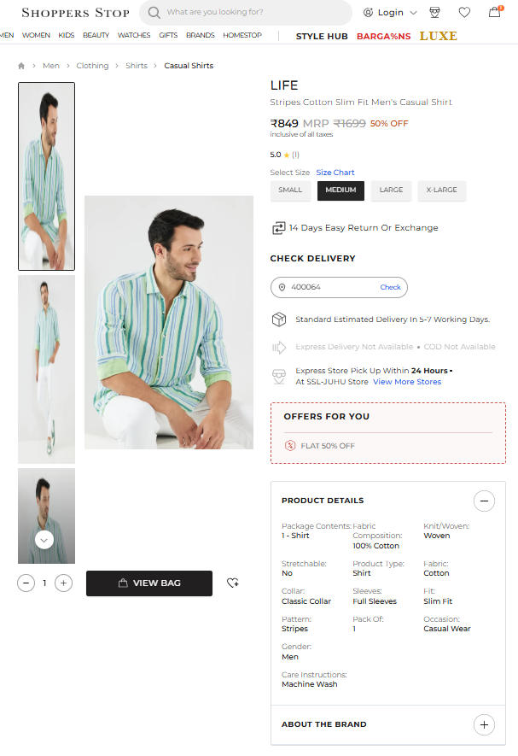
SELECT AND ADD TO CART
SELECT THE PRODUCT AND ADD TO CART
THE PRODUCT WHICH YOU SELECT

Slide 8

03
BUY AND ADDRESS
BUY THE PRODUCT AND FILL THE ADDRESS

Slide 9
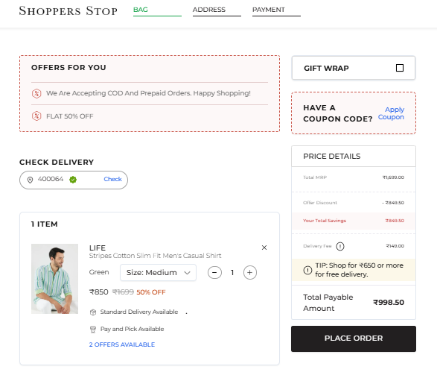
BUY AND ADDRESS
BUY THE PRODUCT AND FILL THE ADDRESS
BLOCK

Slide 10
04
PAYMENT SYSTEM
TO PAY YOUR BILL

Slide 11
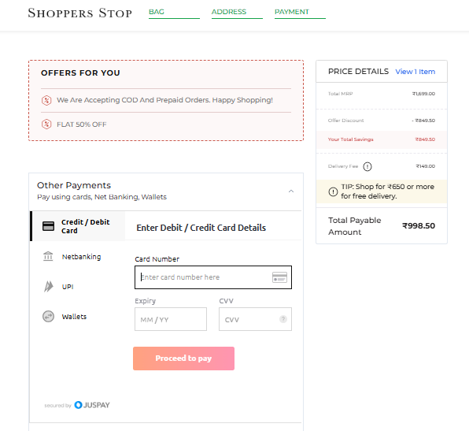
PAYMENT SYSTEM
IN THE PAYMENT SYSTEM ONLY ONE PAYMENT OPSTI0N IS ONLINE PAY OPSTION
AFTER YOUR PAY YOUR AMOUNT
THEN THE WEBSITE ARE TOTALY REFRESH

Slide 12
ABOUT US
DEVELOPER :-
DEVENDRA PATIDAR
PRIYANSHU CHINCHORE

